Slide 1
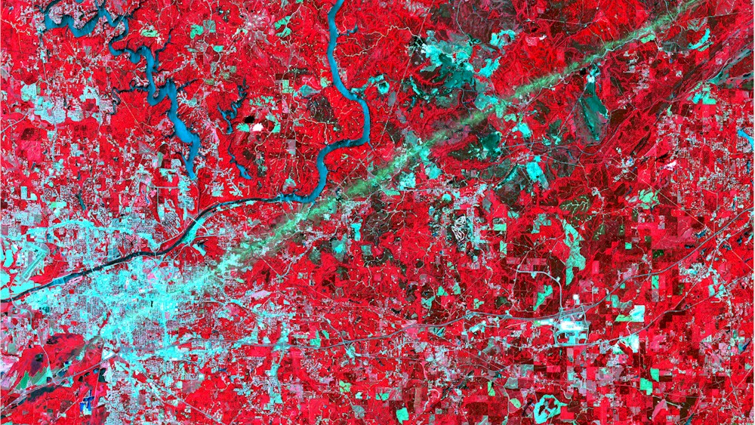
A New Optical Trapezoid Model for Remote Sensing of Soil Moisture

Slide 2
Contents
Introduction to Soil Moisture
Study Area
Importance of Soil Moisture
Remote Sensing of Soil Moisture
Limitations
Objective
Methodology
Results and Discussion

Slide 3
Introduction to Soil Moisture
Soil Moisture is a very important factor in agriculture and plays an essential role in crop production throughout the growing season. It is required for the germination of seeds and as soon as growth starts it serves as a carrier in the distribution of mineral nutrients to the crop
The Soil moisture is the fundamental step in agricultural production, it measures of plant water status which is required to better understand the mechanisms of plant response to take stress of water. So that the further optimization of crop production can be done through precise irrigation practices.

Slide 4
Lack of assuring approach of measuring soil moisture is a serious problem at global level. In day today’s world there is a need for continuous measurement of soil moisture having global coverage.
As the soil moisture control and prediction is essential for the perfect growth of the crop.
Soil moisture would be a valuable input to the current hydrologic, climatic, agricultural, and biogeochemical models if it could be reliably measured at appropriate spatial scales and over time intervals.

Slide 5
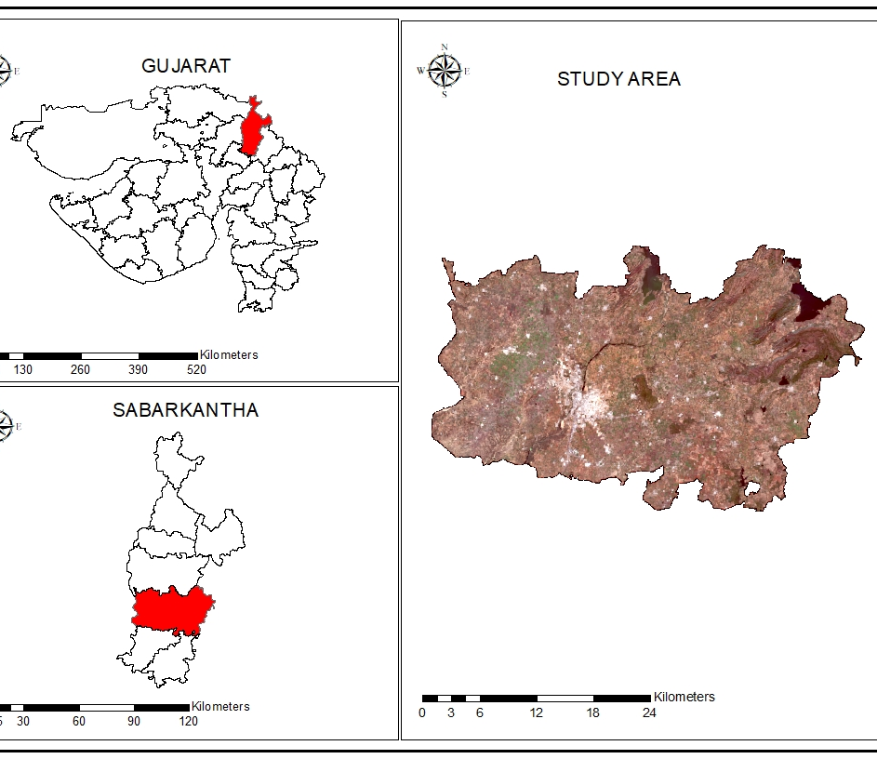
Study Area
The study area in this project is Himatnagar taluka of Sabarkantha district which is situated in north eastern part of Gujarat state.Himatnagar is stated as the administrative headquarters of Sabarkantha district.
This study area is chosen particularly for Rabi season.
The major crop grown in rabbi season in this taluka are Wheat, Potato, Maize, and Mustard.

Slide 6
Importance of Soil Moisture
Soil moisture is a key variable in controlling the exchange of water and heat energy between the land surface and the atmosphere through evaporation and plant transpiration. As a result, soil moisture plays an important role in the development of weather patterns and the production of precipitation.
Soil moisture information can also be used for reservoir management, early warning of droughts, irrigation scheduling, and also for crop yield forecasting.

Slide 7
Remote Sensing of Soil Moisture
Research in soil moisture remote sensing began in the mid 1970's shortly after the surge in satellite development.
Quantitative measurements of soil moisture in the surface layer of soil have been most successful using passive remote sensing in the microwave region.
The potential exists today to retrieve soil moisture estimates from space-based instruments at frequencies of about 6 GHz (C band).
However, observations at frequencies between 1 and 3 GHz (L band) are best suited for detection of soil moisture because energy is emitted from a deeper soil layer and less energy is absorbed or reflected by vegetation.

Slide 8
Limitations
All the datasets that are freely available for determining soil moisture are microwave datasets.
The limitation of microwave remote sensing is that they have poor spatial & temporal resolution.
Soil Moisture Active Passive (Smap) spatial resolution 3 km
Advanced very-high-resolution radiometer (Avhrr) spatial resolution 1 km

Slide 9
Objective
Estimation Soil Moisture with Optical Remote Sensing

Slide 10
Methodology

Slide 11
Sentinel-2
The Copernicus Sentinel-2 mission comprises a constellation of two polar-orbiting satellites which gives freely available data.
Because it is constellation of two polar-orbiting satellites it gives a temporal resolution of 5 days if both the satellites are under cloud-free conditions.
It gives a spatial resolution of 10-20 meter.

Slide 12
Thermal-Optical Trapezoid Model
The trapezoid model is one of the most widely applied approaches to RS of soil moisture utilizing both optical and thermal data.
The model, is based on the interpretation of the pixel distribution within the land surface temperature-vegetation index space.
This model suffers from two inherent limitations.
It is not applicable to satellites that do not provide thermal data.
It requires separate parameters for each individual observation date.

Slide 13
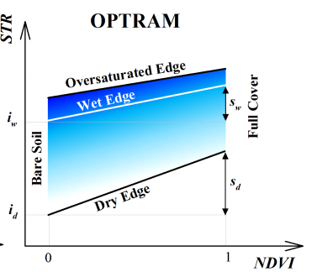
Optical Trapezoid Model (OPTRAM)
Optical Trapezoid Model is based on a relationship between soil moisture and shortwave infrared transformed reflectance.
The OPTRAM mainly uses Visible, Near Infrared and Short Wave Infrared reflectance properties for the construction of vegetation and water indices and estimates soil moisture content within the field.

Slide 14
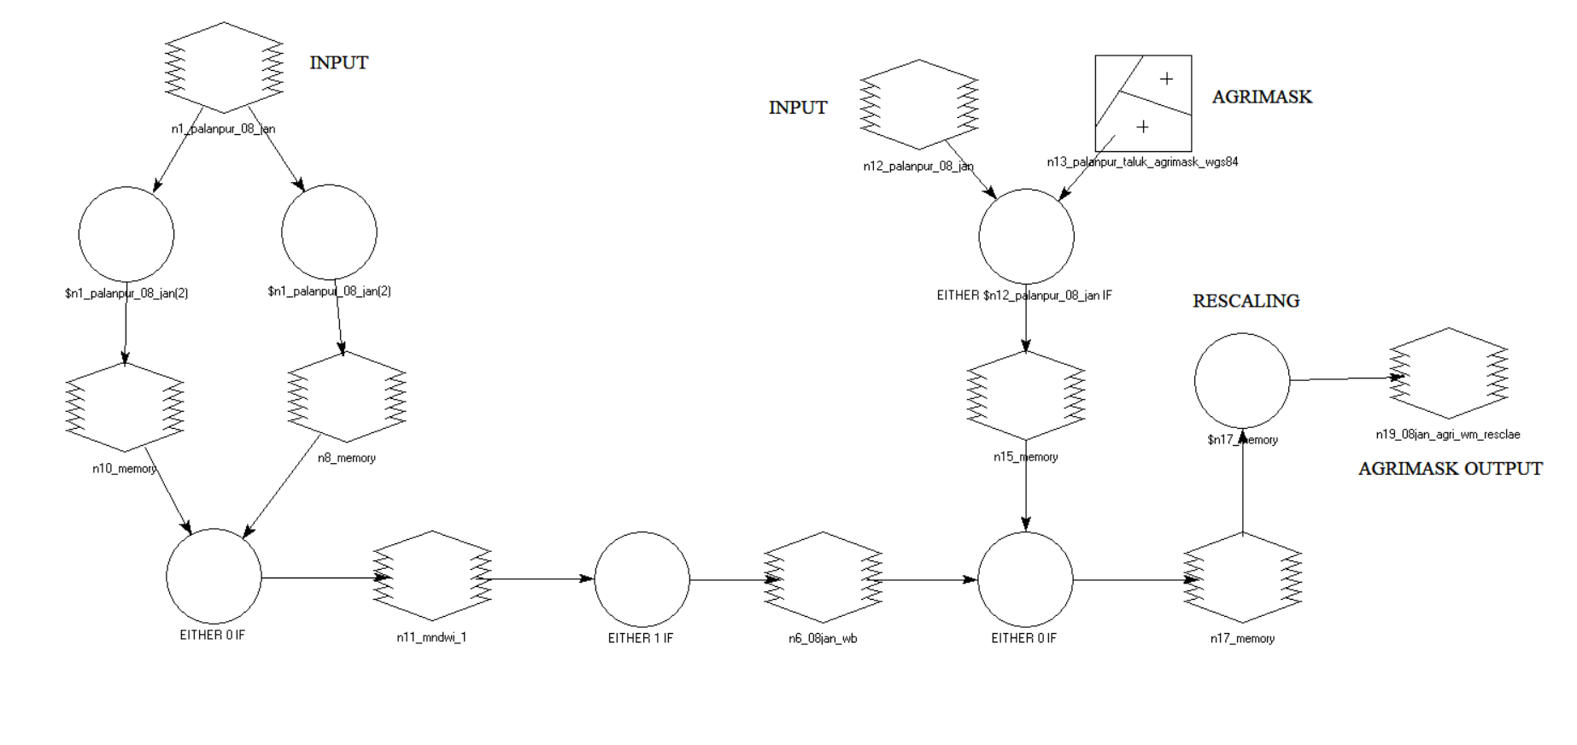
Agrimask & Modified Normalized Difference Water Index(MNDWI)

Slide 15
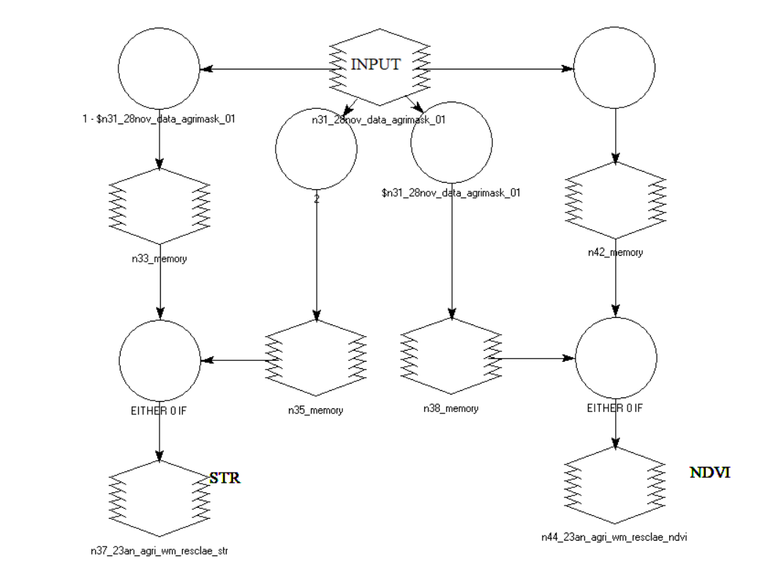
NDVI & STR

Slide 16
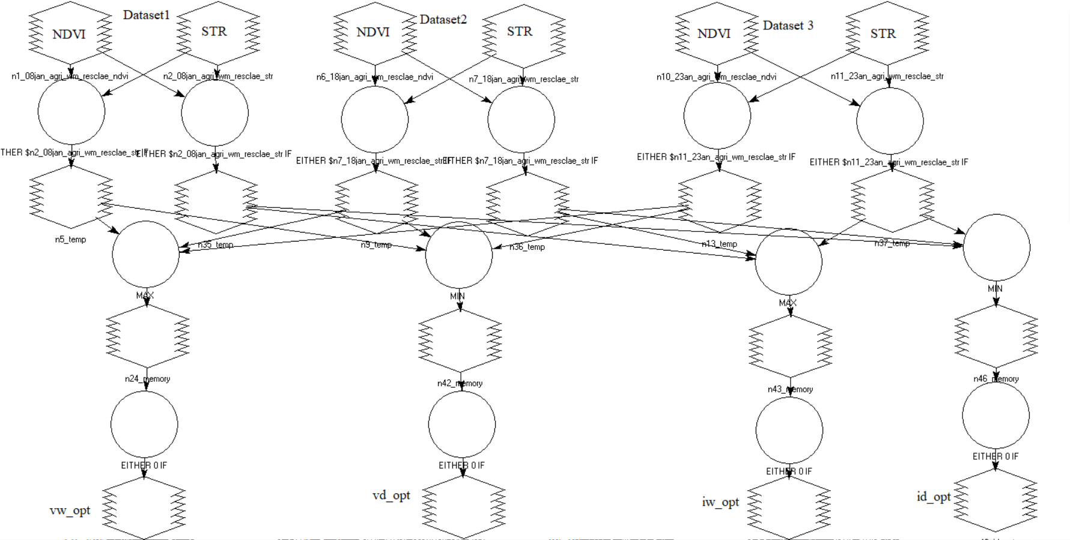
Linear Dry and Wet edges

Slide 17
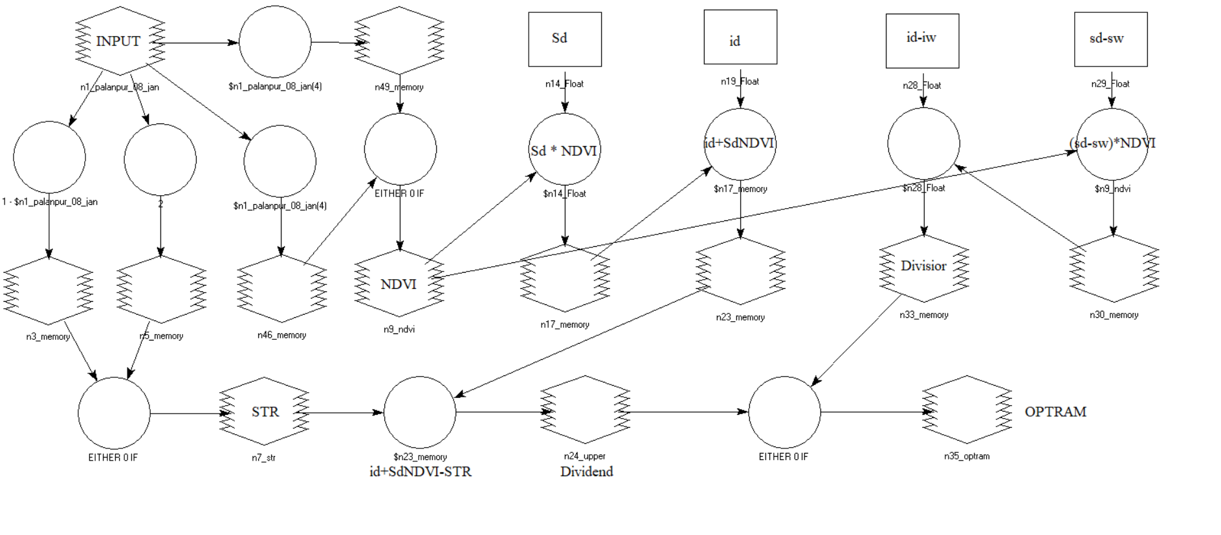
Optical Trapezoid Model

Slide 18
Results and Discussion

Slide 19
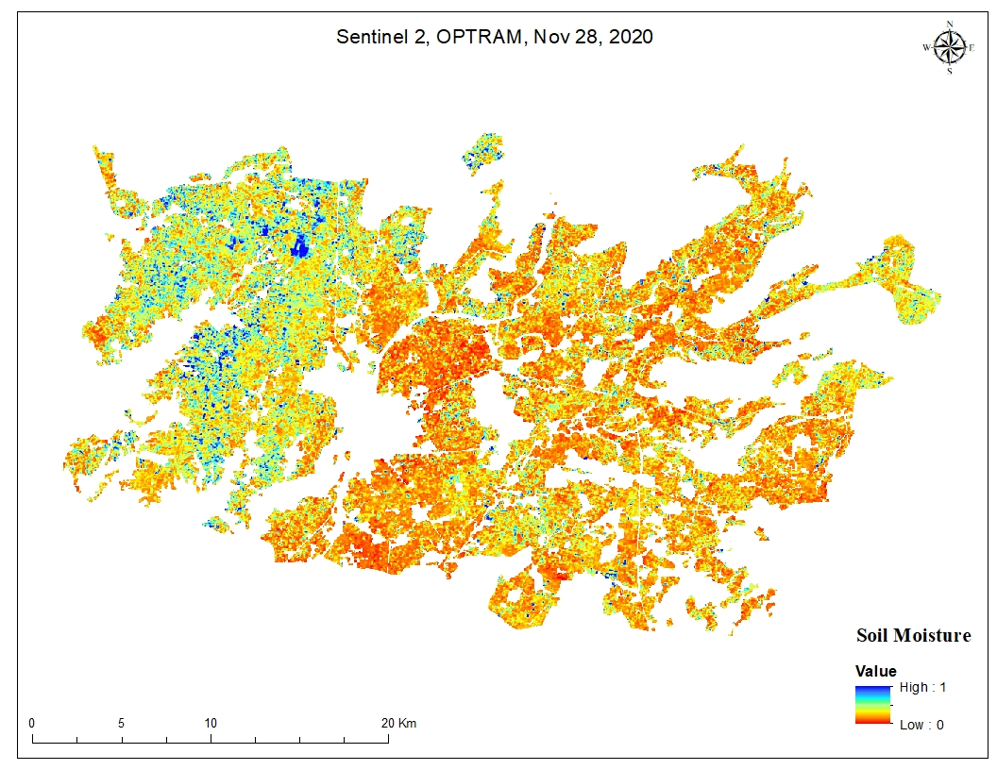
Soil moisture image of 28th November 2020
The sowing has taken place in few villages, as the maximum sowing happens at the end of November and mid-December. The map shows 0.4991cm³ of soil moisture in few villages of Himatnagar taluka.

Slide 20
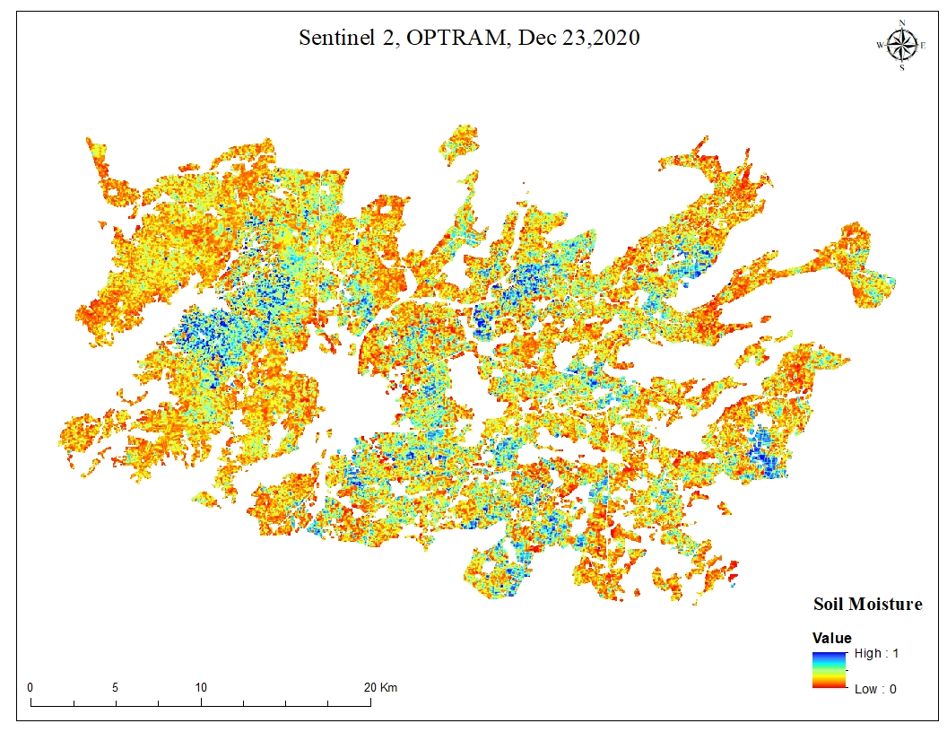
Soil moisture image of 23rd December 2020
The image is showing increase in soil moisture in large percentage and the spread of moisture all over the taluka. The moisture has increased from 0.4991cm³ to 0.5005cm³.

Slide 21
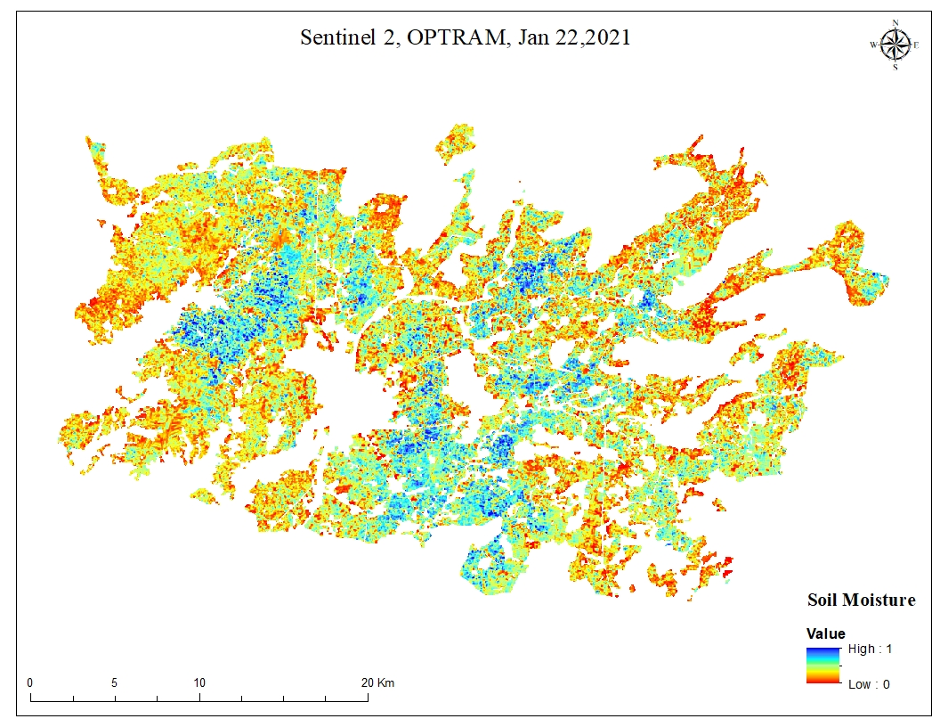
Soil moisture image of 22nd January 2021
In the month of January the soil moisture has reduced a bit 0.4508cm³.

Slide 22
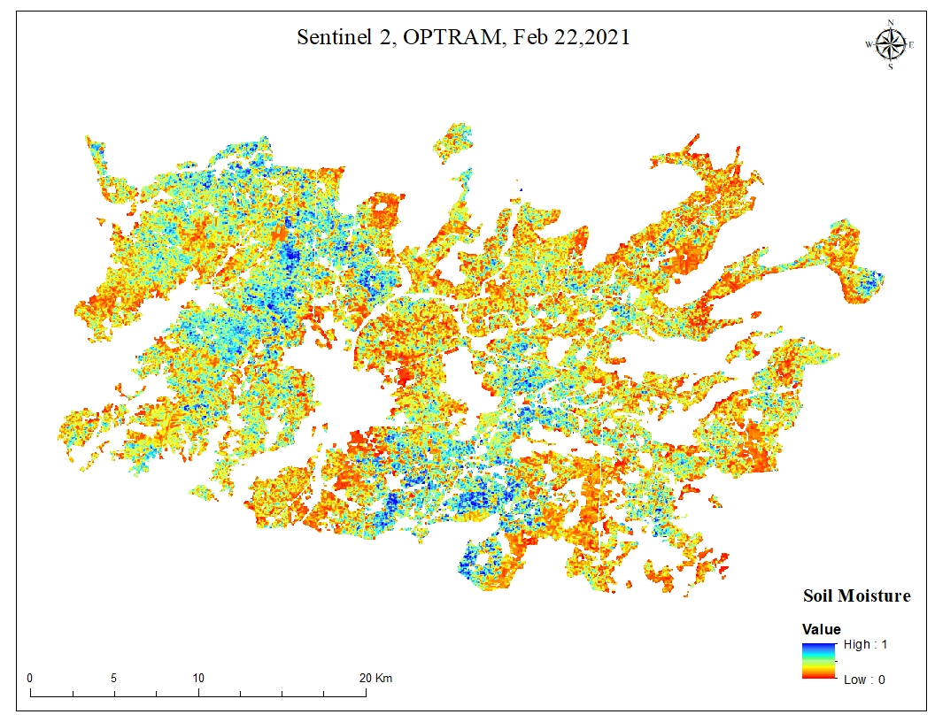
Soil moisture image of 22nd February 2021
This image shows the increase in soil moisture level 0.4762cm³ compared to the soil moisture level of January.
The crops in this image will be at its peak stage and irrigation practices will be taking place as compared to the earlier month.

Slide 23
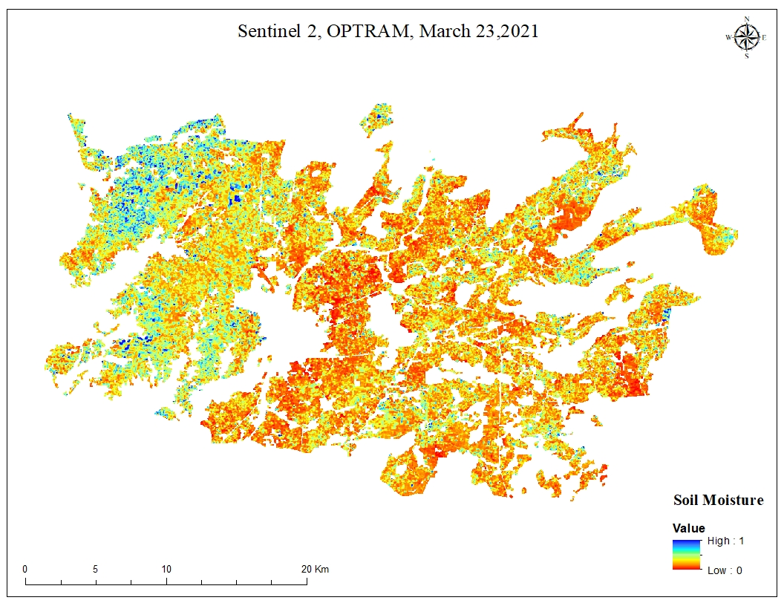
Soil moisture image of 23rd March 2021
This image shows the lowest soil moisture in all five months timespan.
The reason for receiving the lowest soil moisture is due to the harvesting stage.
The rabbi crops are harvested at the end of the march and because of this the moisture value received in the image has decreased.

Slide 24
Thank you!

